Slide 1
Society
Sambayanan

Slide 2
IceBreaker
Notes:
Click the link to instructions: https://docs.google.com/document/d/1o4E5Nk1Yiz0xnwJGATuEjVc6rV4NSpQQ1GLaA2rA2nk/edit?usp=sharing

Slide 3
How can we promote a positive outlook?

Slide 4
Walk-Around
Different scenarios around the room, write at least one thing that has not been said before.
--------------------------------------------
If you had this issue, what do you
think would be helpful?

Slide 5
Reflect!

Slide 6
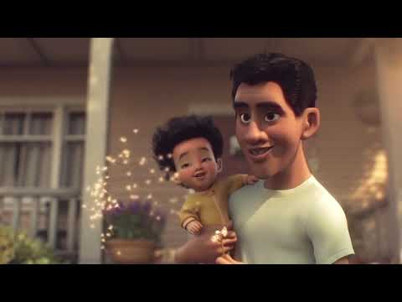

Slide 7
Kitakits Mamaya!

